Slide 1
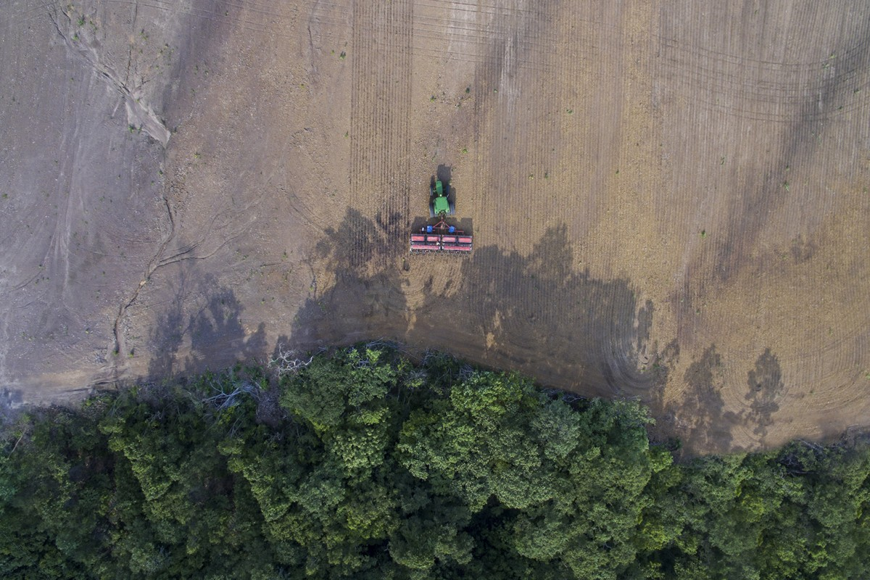
Planting and harvest dates of Brazilian soybean
http://www.dronestagr.am/tag/planting-and-harvesting-soybeans-brazil-brasil-soy/
Minghui Zhang
EFMH meeting
October 3, 2018
Notes:
Today I’m going to talk about my research on planting and harvest dates of soybean in Brazil. The first part uses remote sensing data to estimate when farmers plant and harvest soy in Brazil, and then use statistical analysis to decipher the climate controls on planting date decisions. The idea is that knowing when and why these crop timing decisions occur can help us understand the bigger picture of the connections between agriculture, climate change and land use change.

Slide 2
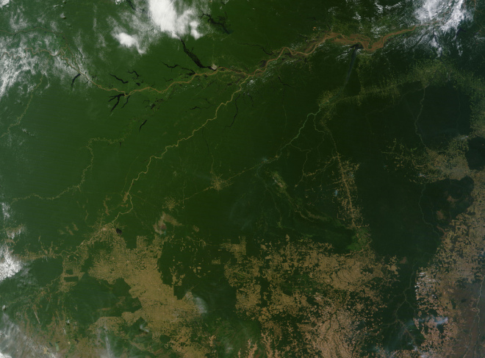
Agriculture is the largest terrestrial biome on Earth.
https://blogs.dw.com/globalideas/tag/hydropower/
Notes:
This is an aerial image of the Amazon in northern Brazil. You can see the river and rainforest in the north, and a lot of deforestation in the south. Much of this clearing is for pasture and soy. So we can begin to see evidence of how much agriculture is changing the face of the Amazon.
The same thing has happened globally as well. Already, agriculture is the largest terrestrial biome and covers 40% of land surface. It has replaced or altered 30% of forests, 50% of savanna, and 70% of grassland.
----- Meeting Notes (10/3/18 12:56) -----
add outline of deforested area

Slide 3
Agricultural expansion creates a ‘no-win’ scenario for food production
Land use change
GHG emissions
Local energy + water fluxes change
Biogeochemical
climate change
Biophysical climate change
Extreme weather
Warmer and drier climate
Lower agricultural productivity
Notes:
This kind of agricultural expansion might be essential to our immediate survival but it might also threaten our future.
Agricultural expansion, and the land use change associated with it, can cause climate change that ultimately reduce agricultural productivity.
There are two ways this can happen. The first is a scenario that we’re all familiar with. Land use change has directly caused 35% of anthropogenic emissions since 1850, which increases global radiative forcing, which can intensify weather variation, and increase the likelihood of extreme and highly damaging heat waves, droughts, and flooding. All of these, of course, cause a decline in yield. I’m going to label as biogeochemical change.
The second pathway for this ‘no win’ scenario is arguably more intense, especially at the local scale. This is the biophysical change caused by clearing native vegetation and replacing it with crops. Because the crops typically have lower albedo, lower surface roughness, and shallower roots than the vegetation that they replace, this changes energy and water fluxes, such as the net radiation at the land surface, the partitioning of energy into latent and sensible heat, and the partitioning of rainfall into runoff, soil water, and evapotranspiration. In the tropics, these shifts in the fluxes increase the temperature at the land surface, reduce rainfall, and cause a shorter rainy season. All of these lead to a decline in yield.
Both extreme weather and a warmer and drier average climate can contribute to a decline in agricultural yields. In short, this is ‘no win scenario’ because the more you deforest in the name of increasing agricultural productivity, the less productive agriculture becomes.

Slide 4
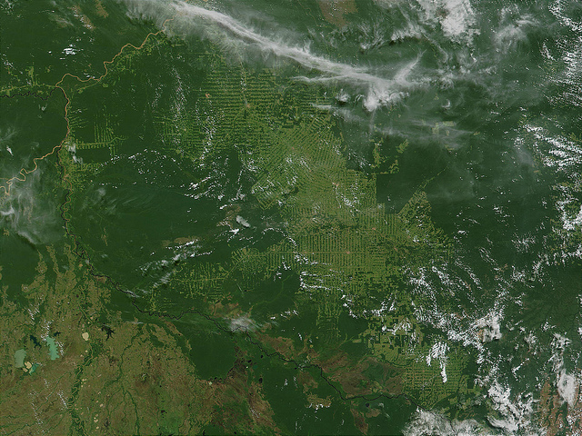
Forests provide climate regulation services for neighboring agriculture, especially in the tropics.
https://blogs.dw.com/globalideas/tag/hydropower/
Notes:
The conclusion here is that keeping forests around can improve agricultural productivity because forests provide climate regulation services. Without them, crops experience a hotter, drier, less predictable, less hospitable climate.
However, this service isn’t spatially homogenous. The ability of forest to maintain cool temperatures is especially strong in tropical forests and savannas, so it’s important to make this a focus of study.

Slide 5
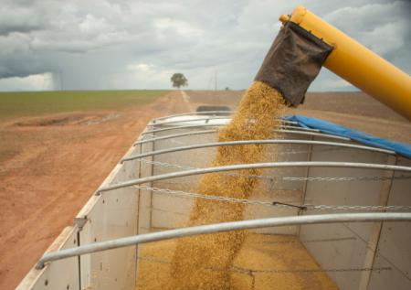
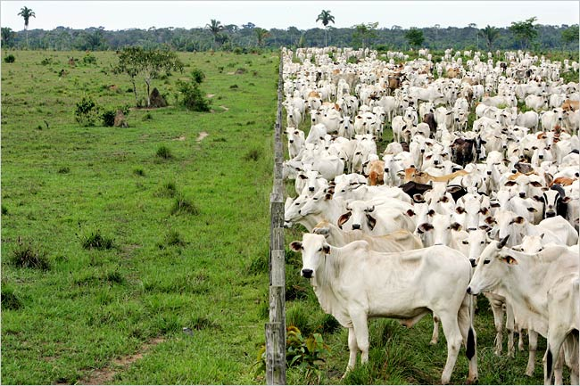
Brazil’s agricultural sector is both a driver of climate change and vulnerable to its effects.
https://globalforestatlas.yale.edu/amazon/land-use/soy
https://www.nytimes.com/2007/01/14/world/americas/14amazon.html
One-month reduction in wet season length due to deforestation (Sampaio et al, 2007)
Notes:
Within the tropics, Brazil’s agricultural sector is simultaneously an enormous driver of climate change and also especially vulnerable to the effects of that change. In the past few decades, it has experienced some of the world’s highest deforestation rates, driven primarily by cattle ranching and soy expansion.
In heavily planted parts of Brazil (Cerrado), deforestation has already contributed to a one-month reduction in the duration of the wet season. The shorter wet season is especially bad news for rainfed agriculture, like soybean, which rely on rainfall at the right times of the year.

Slide 6
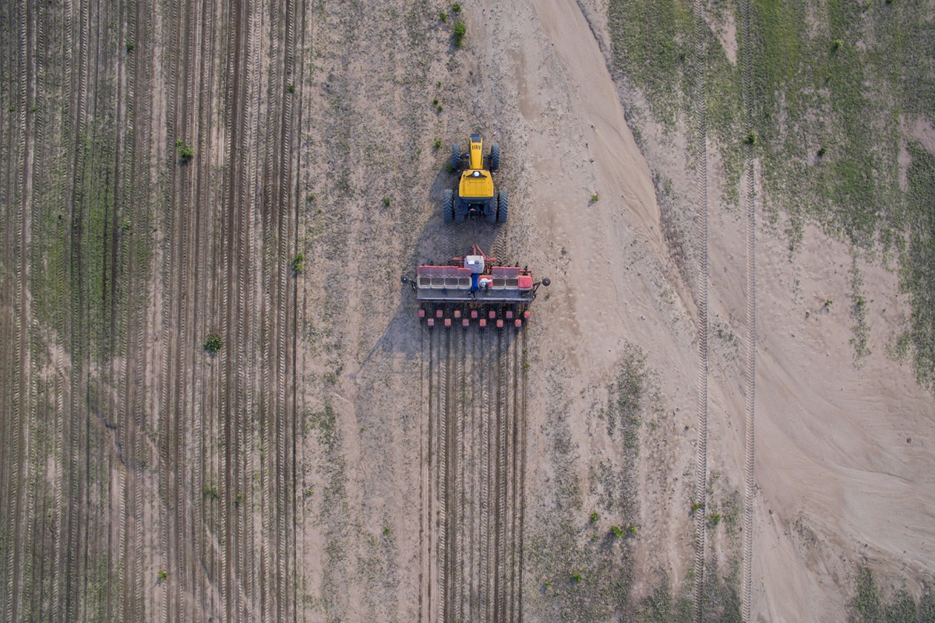
Land use change
Lower agricultural productivity
http://www.dronestagr.am/tag/planting-and-harvesting-soybeans-brazil-brasil-soy/
Hypotheses:
Planting and harvest dates be estimated from remotely sensed data.
Statistical analysis will uncover the the strength of climate controls on crop timing.
Notes:
We suspect that planting and harvest date decisions are a part of this whole picture of how land use change causes climate change, causing a decrease in agricultural productivity. If the planting date is forced to be later because the wet season comes later, productivity might be less than optimal.
For my research, I’d like to propose two hypothesis: first, that we can estimate planting and harvest dates with the help of remotely sensed data. Second, climate variables exert a control on crop timing, and we can uncover this with statistical analysis.

Slide 7
Presentation Outline
1. Estimate soy timing at field scale with remotely sensed data
Introduce timeseries analysis method
Preliminary MODIS-derived results
Improving estimates with Landsat and Sentinel
2. Define the controls on planting date decisions
Introduction
Timing estimation
Statistical analysis
Notes:
For the rest of my presentation, I’m going to walk through these two research questions in detail.
The first research task is to estimate field scale information about planting and harvest dates. This is necessary because field scale data over Brazil are scarce. Data collection requires extensive survey work, and it’s impractical at scale. Fortunately, there’s a rich variety of information that we can get from remotely sensed images. I’m going to begin by describing my timeseries analysis method and show you some preliminary results from one data set, MODIS. Next, I’m going to describe my planned work on incorporating more information from additional remotely sensed sources – specifically, Landsat and Sentinel – because each comes with unique advantages and disadvantages.
The second research task is to define the strength of the climate controls on timing decisions. I’d like to see whether changes in weather variables actually causes a change in crop timing. In this section, I’ll describe the statistical methods that will help me relate historical variations in timing decisions to their climate controls.

Slide 8
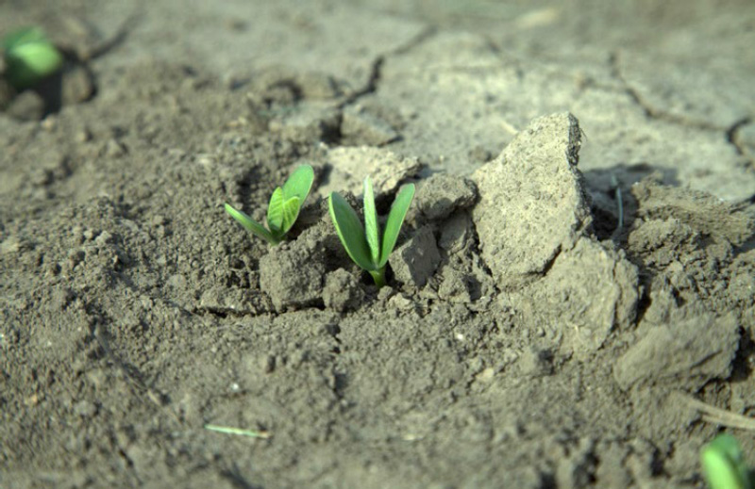
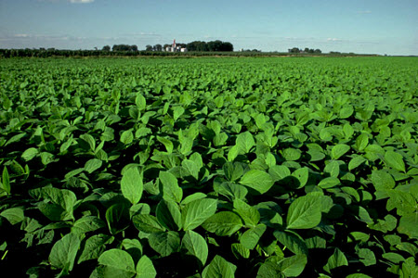
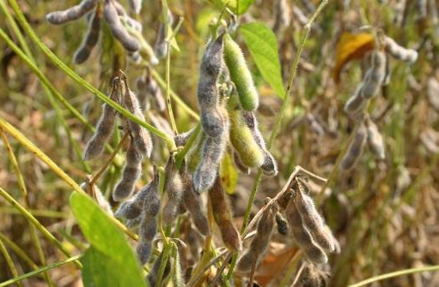
Remotely sensed vegetation indices track crop development
Vegetation index
Day 1
Day 365
Emergence
Peak
Maturity
Introduction
Timing estimation
Statistical analysis
Notes:
Coming back to the first task to estimate crop timing, I’m going to rely on the fact that remotely sensed information changes over time in response to the greenness of the land surface. In general, surface reflectances detected by a sensor can be turned into a vegetation index, which is a measure of the greenness, or leaf area, of the plants. Soy emerges from the soil a few weeks after planting and begins to accumulate biomass, reaching a peak in the middle of the crop window, and then declining as the plant reaches maturity. Vegetation indices can closely follow this progression.

Slide 9
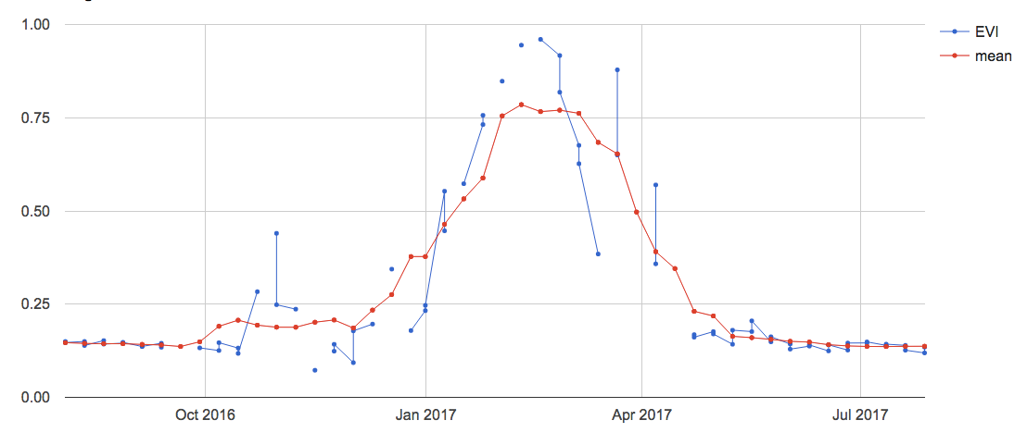
Estimate plant/harvest with timeseries analysis
MODIS-derived EVI
EVI
Moving average EVI
Emergence
Peak
Maturity
https://www.pioneer.com/home/site/us/agronomy/library/nitrogen-fertilizer-for-soybean/
Introduction
Timing estimation
Statistical analysis
Notes:
Here’s an example of how a vegetation index, in this case EVI, changes over time for a soy pixel. The blue is the raw data, filtered for clouds. So you’ll notice some missing data points. You can see that the timeseries is quite noisy, so the red is the result of a moving average window.

Slide 10
Peak and greenup dates -> planting and harvest date estimates
Greenup = maximum of first derivative
Peak =
fitted with harmonic function
EVI
Greenup + peak dates
Plant + harvest dates
Calibration dataset
(Survey of 90 farms)
Introduction
Timing estimation
Statistical analysis
Notes:
Our goal is to relate a timeseries like this to planting and harvest estimates.
Of course we can’t actually see when a crop is planted using remote sensing because there’s no vegetation on the ground yet. So we need to orient ourselves on things we can actually detect using timeseries analysis: in this case, the peak, and the greenup, or the date when vegetation growth is fastest. Once peak and greenup are found, we need to relate them to plant and harvest dates.
Fortunately, we have a calibration dataset, which is a survey of 90 farms over the course of 10 years, to determine an equation that relates the peak and the greenup point to planting and harvesting date.

Slide 11
MODIS-derived planting date estimates in 2016
Planting date (since Aug 1)
Introduction
Timing estimation
Statistical analysis
Notes:
Now that I have a timeseries analysis method, I can use it on MODIS data. Here’s an example of what the planting date looks like for 2016. You can see a distinct spatial pattern in planting dates.
----- Meeting Notes (10/3/18 12:56) -----
get rid of state's names
different color scheme

Slide 12
MODIS-derived planting date estimates
2005
2015
Planting date (since Aug 1)
Introduction
Timing estimation
Statistical analysis
Notes:
Here’s a look at planting date estimates from two more years. The extent of the estimates looks different because there’s a higher area of planted soy in 2015 than in 2005. Already you can notice that some regions had a change in planting date, while other regions stayed more or less the same.
----- Meeting Notes (10/3/18 12:56) -----
use different color bars for plant/harvest
explain the trend and why that might happen

Slide 13
MODIS-derived harvest date estimates
2005
2015
Harvest date (since Aug 1)
Introduction
Timing estimation
Statistical analysis
Notes:
Here’s a look at harvest date estimates for the same two years. You’ll notice that the areas with earlier harvest are also the areas with earlier planting dates, and vice versa, so it gives a nice sanity check for the estimates.

Slide 14
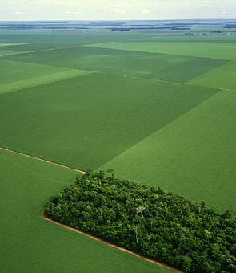
Additional RS products can address the largest sources of error
Mixed pixels issue
https://oecotextiles.wordpress.com/2012/09/19/how-to-buy-a-quality-sofa-soy-foam/soy-brazil-2/
MODIS (500m resolution) can’t distinguish patches of natural vegetation
Introduction
Timing estimation
Statistical analysis
Notes:
The maps I showed above are all derived from Modis, but there are other satellites that may improve our estimate. First, using Modis might introduce the mixed pixel issue. This is a picture of a soy field in Brazil. You can see that there’s a patch of natural vegetation in the middle of it. Modis at the 500m resolution won’t be able to distinguish this.

Slide 15
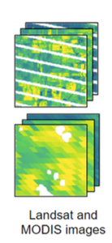
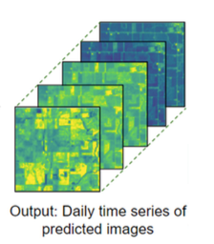
Fuse MODIS and Landsat to address the mixed pixel problem
 | MODIS | Landsat | MODIS-Landsat fusion
Temporal resolution | High (8 days) | Low (16 days) | High (8 days)
Spatial resolution | Low (500m) | High (30m) | High (30m)
(Luo et al, 2018)
Introduction
Timing estimation
Statistical analysis
Notes:
The solution here is of course to use a data product with higher resolution. Landsat is another remotely sensed dataset, which is at 30m resolution instead of 500m. The downside of using Landsat is that it also comes with a lower temporal resolution, its revisit time is 16 days. So, I’m going to combine the strengths by fusing them into a new product, with the high temporal resolution of Modis and the high spatial resolution of Landsat. So moving forward, all my estimates will come from the Modis-Landsat fused dataset, rather than Modis alone. Essentially the same timeseries analysis method that I described will just be applied to a more high resolution dataset.

Slide 16
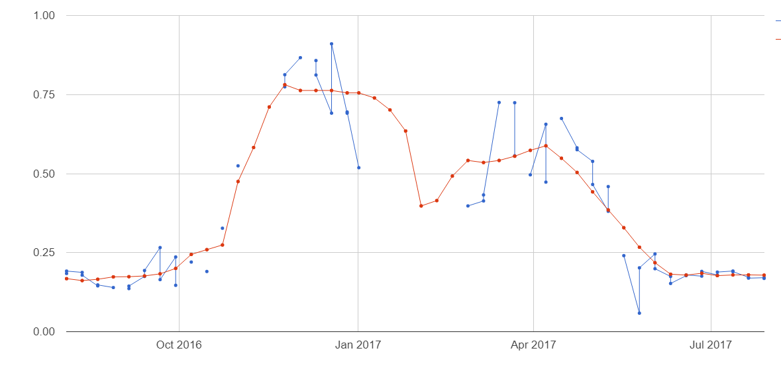
Additional RS products can address the largest sources of error
Low temporal resolution
EVI
8 day resolution only provides a few data points around greenup
Introduction
Timing estimation
Statistical analysis
Notes:
The second issue is that at the relatively high 8 day temporal resolution, there aren’t actually that many data points during the rising limb of this timeseries. In this example, the limb rises quite quickly, over the course of about a month and a half. There are only a handful of points at our disposal to estimate the inflection point. If there are clouds on a MODIS observation day, then our temporal resolution effectively gets lower. So the solution here is to use a satellite that has a high temporal resolution, and equally importantly, one that’s not affected by clouds.

Slide 17
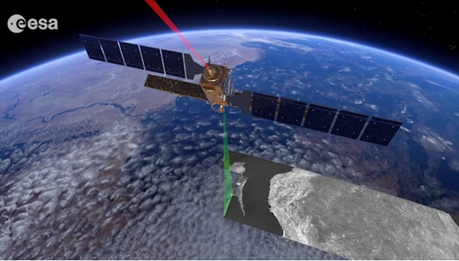
Sentinel’s high revisit time may improve greenup estimates
All-weather sensor eliminates cloud interference
linear
Vegetation index
(Modis-Landsat fusion)
(Sentinel)
Day 1
Day 365
Greenup
Peak
Introduction
Timing estimation
Statistical analysis
Notes:
Here is where our third and final satellite comes in. I’m proposing to use Sentinel to improve our temporal resolution, and thereby improve our greenup estimate. Sentinel’s revisit time is three days, and importantly, unlike Modis and Landsat, it’s not affected by clouds.
Here’s a conceptual picture of what sentinel data looks like compared to the vegetation index derived from Modis-Landsat fusion. The green is the vegetation index derived from the Modis-Landsat fusion product, and the red is the backscatter from Sentinel. Right away you can see that they don’t completely match up. Backscatter saturates during the peak of the season. In fact, the literature reports that backscatter is only linearly related to vegetation indices over a certain range, which happens to be around greenup. So the final estimation method I’m proposing is to use Sentinel to estimate greenup, but for estimating the peak time, we need to stick to the vegetation index from Modis-Landsat fusion.

Slide 18
Presentation Outline
1. Estimate soy timing at field scale with remotely sensed data
Introduce timeseries analysis method
Preliminary MODIS-derived results
Improving estimates with Landsat and Sentinel
2. Define the controls on planting date decisions
Introduction
Timing estimation
Statistical analysis
Notes:
Now we come to the final section of my presentation, where I’ll describe my planned work on defining the climate controls on planting date decisions.

Slide 19
Goal: develop statistical models of planting date
f (climate and non-climate constraints)
Planting date
Change in climate -> change in planting date?
Introduction
Timing estimation
Statistical analysis
Notes:
The goal of this section is to produce a model of planting dates that look something like this. It’s a description of planting date as a function of climate and non-climate constraints. We’re hoping that once this model is finished, we can use it to predict how planting dates might respond to changes in climate variables.

Slide 20
What might control planting date?
Legal Constraints
Economic + Logistic Constraints
Phytosanitary law
Risk zones
Credit available?
Equipment available?
Consider physical constraints
wait
wait
wait
Physical Constraints
wait
Irrigation?
Frost?
Appropriate photoperiod?
plant
wait
Rains are ‘staying’?
Favorable forecast?
wait
wait
‘too late’ to harvest?
Introduction
Timing estimation
Statistical analysis
Notes:
This is a problem with many moving parts. There are a lot of explanatory variables that might go into the statistical model. Before I describe some of the challenges involved in tackling this problem, I’d like to motivate them by describing a conceptual decision tree that a farmer might use when they’re deciding when to plant. Overall, these constraints fall under three categories: legal constraints, economic and logistic constraints, and physical constraints.
There are two legal constraints that determine the window over which farmers can plant. They’re there to minimize the risk of failed crop and minimize the risk of a disease called soybean rust. Next we have economic and logistic constraints. Many farmers rely on credit in order to plant.

Slide 21
Challenges for model specification
1. Unobservable controls on planting date
Access to agricultural credit
Availability of farm equipment
Influence from neighbors
2. Nonlinearities in planting date response
Very dry and very wet months both cause delay in planting
While legal constraints apply, planting date is insensitive to other factors
Introduction
Timing estimation
Statistical analysis
Notes:
Considering all of the factors that go into planting date decisions, there are a couple challenges that need to be addressed. First, there are unobservable controls on planting date. Things like access to agricultural credit, availability of farm equipment, soil type, influence from neighbors can all influence planting date, but we don’t have data to describe it. Second we expect to see significant nonlinearities in planting date response. Very wet and very dry months can both cause a delay in planting. And while legal constraints apply, planting date is insensitive to climate. These are challenges that I’m hoping to address by testing out different specifications for the statistical model.

Slide 22
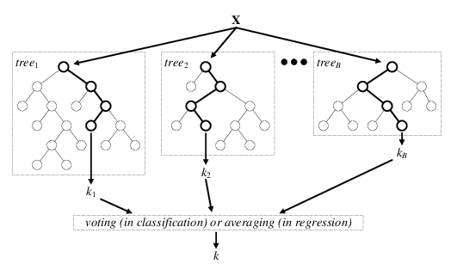
Explore model specifications
OLS regression
plant_{it} = X_{it}β + ε_{it}
Fixed effects regression
plant_{it} = α_{i} + X_{it}β + ε_{it}
Fixed effects (α_{i}) ‘absorb’ unobservable factors
Machine learning (random forest)
https://www.researchgate.net/figure/Architecture-of-the-random-forest-model_fig1_301638643
Introduction
Timing estimation
Statistical analysis
Notes:
I’m going to explore a few general model structures.
First I’ll try doing a simple OLS regression, with planting as the dependent variable and X it are the various explanatory variables for each property I, and each year t. the eta is an error term.
Next I’ll try a fixed effects regression, which is similar to OLS except that it adds in alpha, which is called a fixed effect, that can help absorb unobservable factors.
Finally, I’ll explore machine learning algorithms like random forest. The random forest is based on decision trees, and since we can expect farmers to apply a decision tree like structure in determining their plant dates, random forests might be really effective at capturing the process.

Slide 23
Defining sensitivity of plant date to climate
Model diagnostics
Model selection
Perturbation in climate
Model of planting date behavior
Change in planting date
Introduction
Timing estimation
Statistical analysis
Notes:
At this point I’ll have fitted a bunch of different models. I’ll use some predefined model diagnostics to choose the best model to describe planting date behavior.
The endpoint of my research will be to then input some perturbations in climate, maybe due to land use change, and use the model to calculate the corresponding change in planting date.

Slide 24
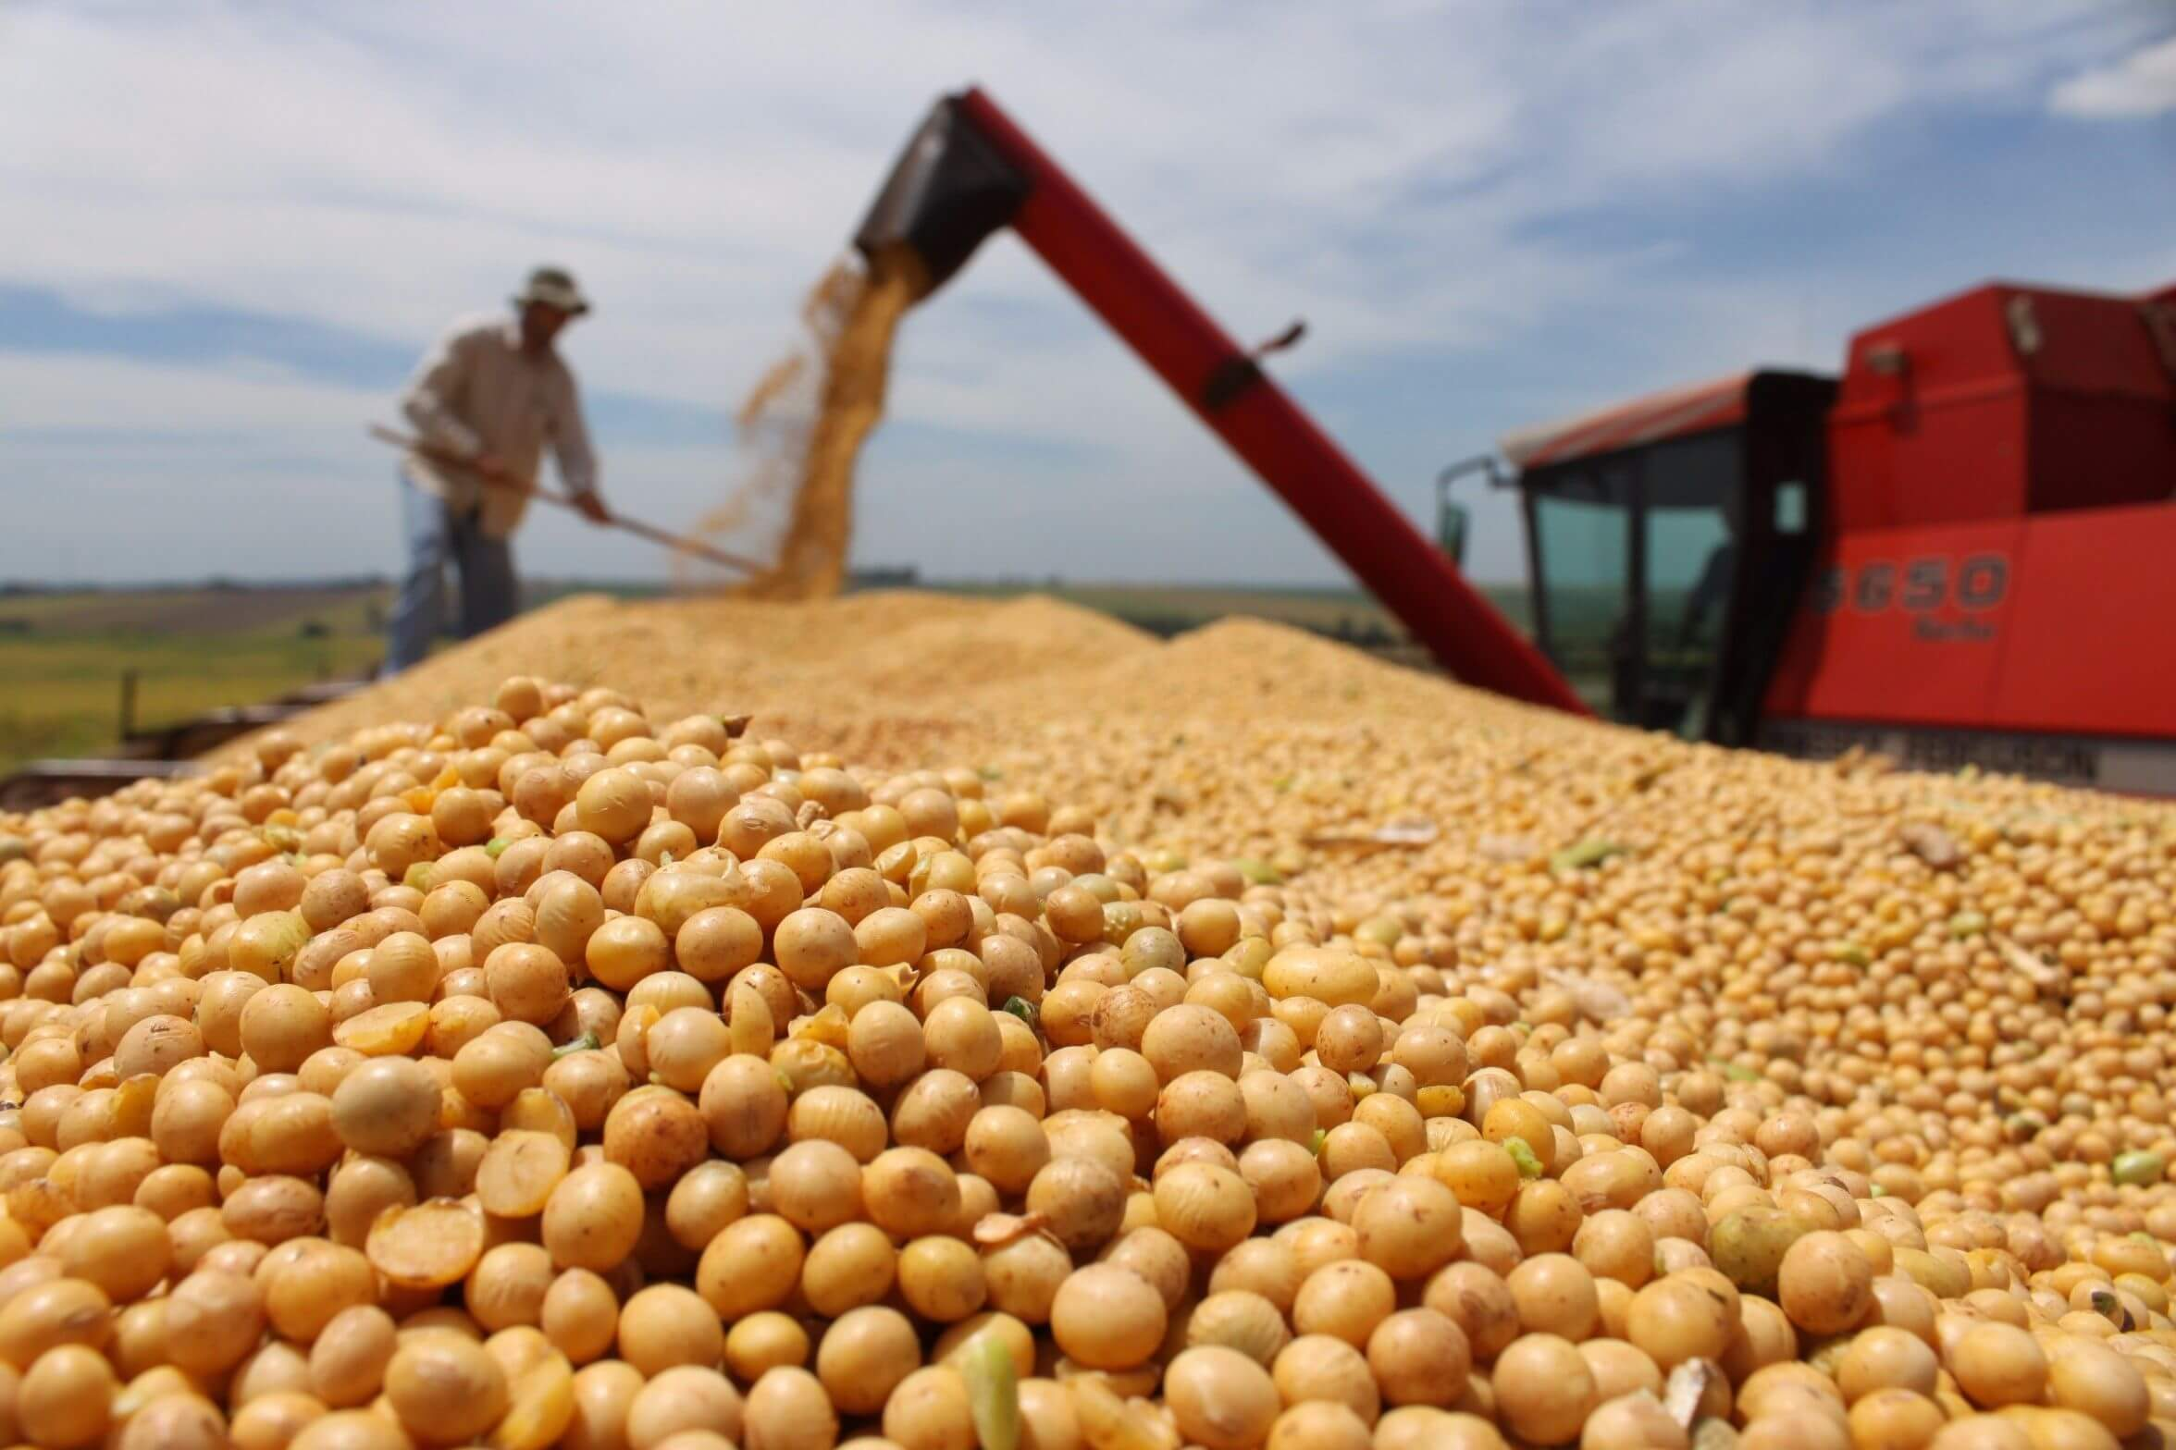
Implications
Predict how growers will shift planting in response to climate.
Input to crop models that predict agricultural productivity
Photo credit:
https://geneticliteracyproject.org/2018/06/07/how-herbicide-resistant-gmo-soybeans-transformed-brazils-economy/
Notes:
I’d like to conclude with a couple implications of this research. First, the statistical model that I build can predict how farmers will shift planting dates in response to anomalies in future climate, for example due to biophysical change. Finally, the planting and harvest date maps that I produce in the first section are an important input to crop models. A lot of models currently use rules of thumb for planting and harvest date, which might not be very accurate. Actual planting and harvest dates could really improve estimates of how agricultural productivity responds to climate change.

Slide 26
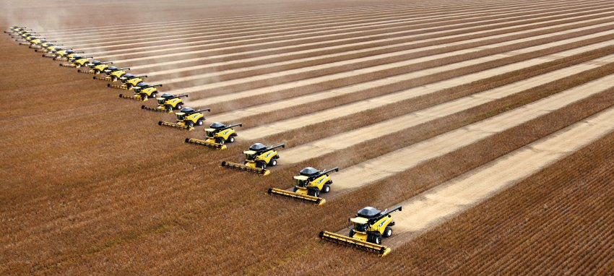
http://climateerinvest.blogspot.com/2011/09/how-they-harvest-soybeans-in-brazil.html
Global food security depends, in part, on the sensitivity of Brazilian soy production to climate change.
Notes:
This is a photo of how soy is harvested in Brazil, dozens of machines combing the landscape. It gives you a feel for what an enormous undertaking soy is in Brazil.
In fact, Brazil is the world’s second largest producer and exporter of soy, and its products provide food and animal feed around the world. So you could argue that Brazilian soy plays an important role in global food security. And by extension, global food security depends in part on the sensitivity of its soy production to climate change.

Slide 27
What might control crop timing?
Irrigation
Introduction
Timing estimation
Statistical analysis
Notes:
Trace the impact of weather fluctuations on plant/harvest dates

Slide 28
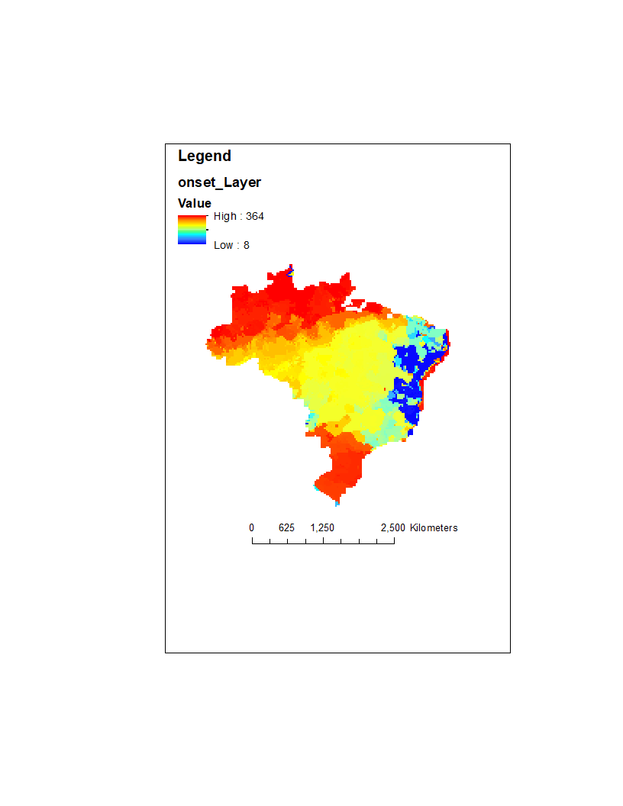
What might control crop timing?
Onset date of wet season in 2010
Onset Day of Year
Introduction
Timing estimation
Statistical analysis
Notes:
Trace the impact of weather fluctuations on plant/harvest dates

Slide 29
What might control crop timing?
Property size
CAR polygon sizes (go with Matopiba)
Introduction
Timing estimation
Statistical analysis
Notes:
Trace the impact of weather fluctuations on plant/harvest dates

Slide 30
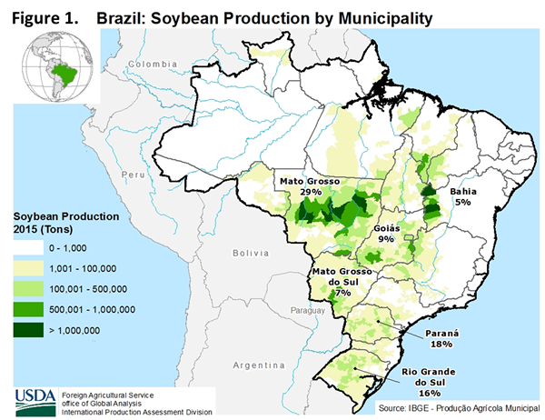

Slide 31
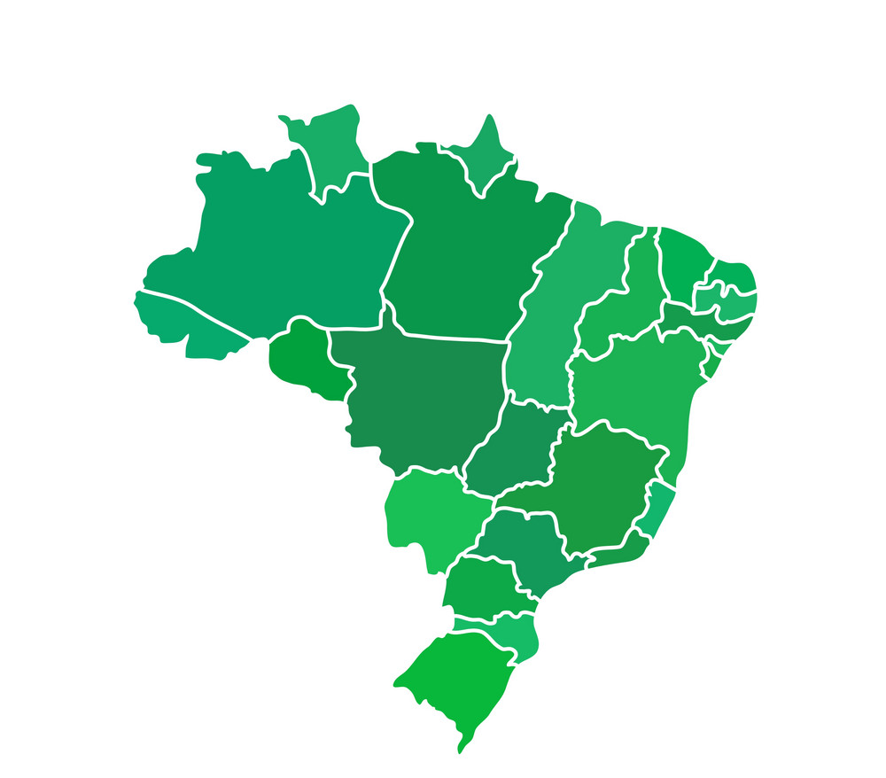
Calibration dataset
Introduction
Timing estimation
Statistical analysis

Slide 32
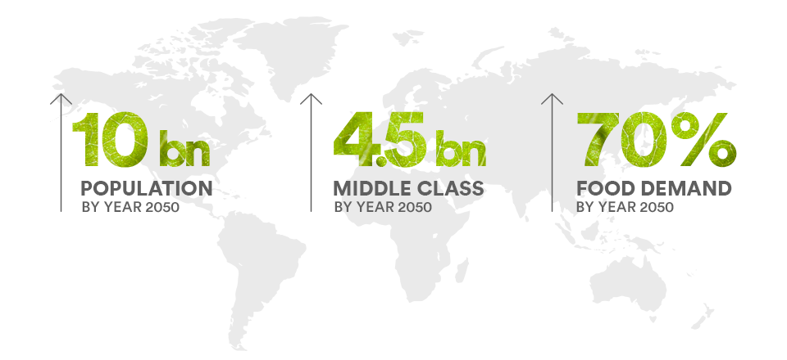
http://thriveagtech.com/the-challenge/
Notes:
You could argue that this kind of expansion is needed. In about thirty years, it’s predicted that we’ll have 10 billion people to feed. The demand for meat will rise with a rising middle class. The population growth and dietary changes will cause a seventy percent increase in food demand by 2050.
Therefore, agricultural production is expected to increase, and with it, probably a growth in agricultural land area. A disproportionate part of this growth currently occurs in the tropics, where the vast majority of new croplands are replacing forest.

Slide 33
Climate change might indirectly impact soy production by forcing a shift in the growing season.
Unconstrained (optimal) timing
Shorter dry season
Cooler, longer wet season
Shorter dry season
August 1
July 31
Crop window
Climate-constrained (sub-optimal) timing
Longer dry season
Warmer, shorter wet season
Longer dry season
August 1
Crop window
July 31
Notes:
Climate change impacts soy productivity both directly and indirectly.
Fluctuations in solar radiation, water availability, and temperature during crop growth directly affect yields. However, much of the damage inflicted by climate change may appear indirectly as a shift in the growing season itself. Here’s a look at a year under normal climate conditions. We typically begin the crop year on August 1, which is usually in the middle of the dry season. Around October and November, the wet season will begin. Let’s say the optimal planting date, the date that maximizes yield, is at the start of the wet season. The crop is planted, and after maybe four months, it’s harvested. The time between the plant date and harvest date is then the crop window.
That’s under normal climate conditions. Now what if climate changes due to land use change? In Brazil, it’s been shown that the dry season will get longer, the wet season will get shorter and warmer. Now perhaps the planting date is forced to be later, and therefore is less than optimal. When temperatures climb, crops develop and become mature faster, so the harvest date might come sooner than four months after the planting date. A shorter crop window usually means less time to accumulate biomass, which then leads to lower yields.
So, crop timing decisions are a central piece to understanding agriculture’s sensitivity to climate change.

Slide 34
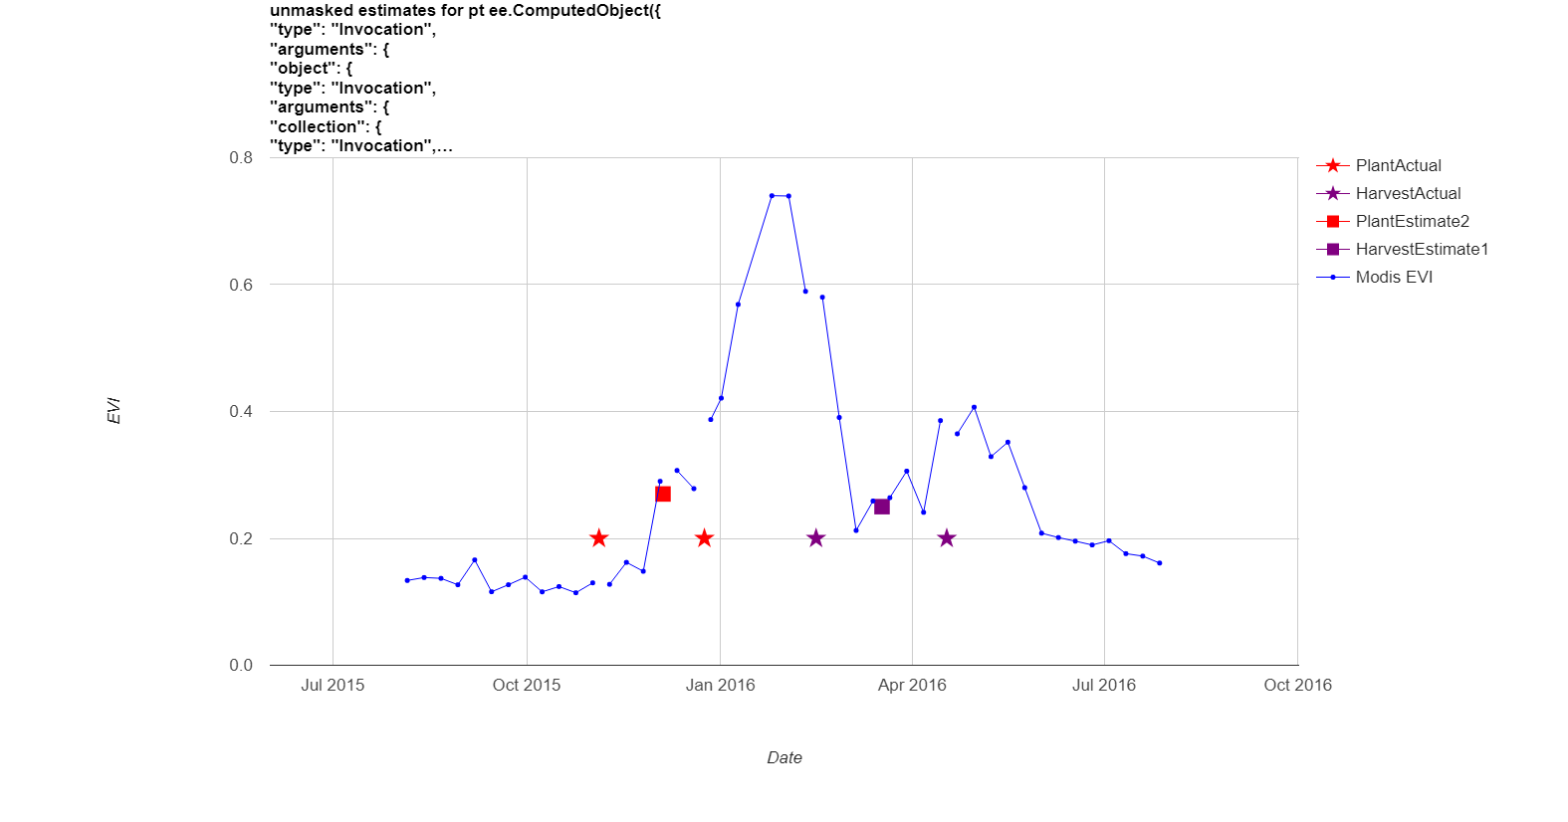
Peak and greenup dates -> planting and harvest date estimates
Reported planting
Reported harvest
Estimated planting
Estimated harvest
EVI
EVI
Date
Introduction
Timing estimation
Statistical analysis
Notes:
This is an example of what this calibration looks like. The blue again, is EVI, for another pixel this time. The red stars mark the actual start and end of planting in that year. They span a lot of dates because the properties can be huge, and it takes a lot of time to plant. And similarly, the purple stars mark the actual start and end of harvest in that year. The red square is the calibrated planting date, and the purple square is the calibrated harvest date. So the goal for calibration is to come up with a function of peak and greenup date that will get as many of these squares in between the stars as possible.

Slide 35
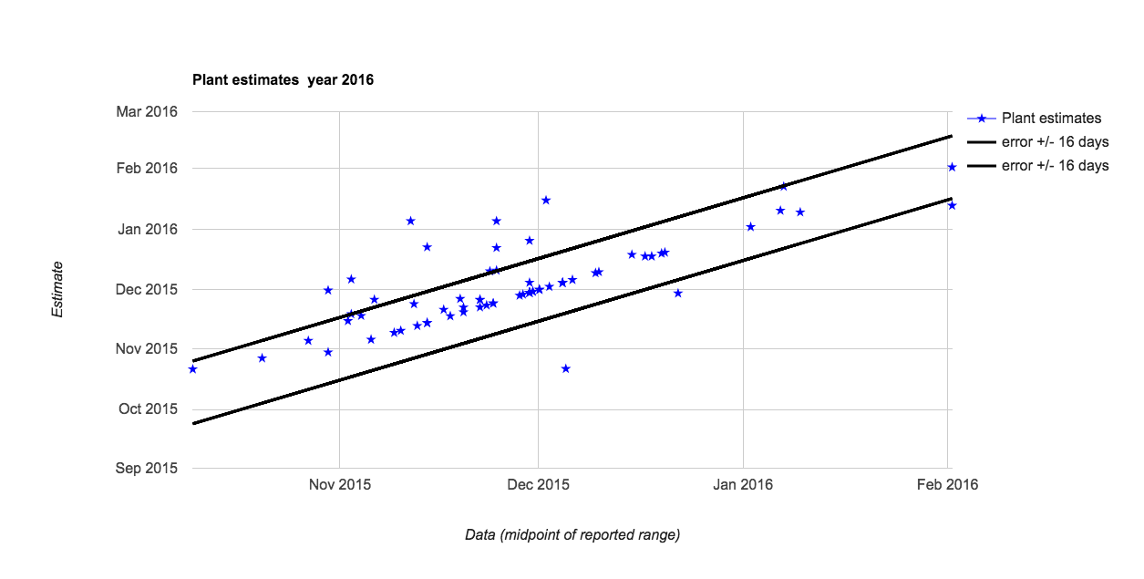
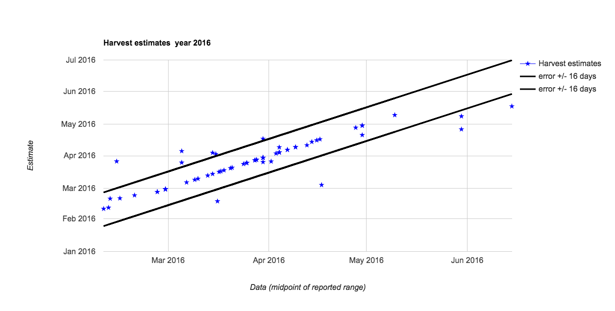
Calibration performance
Plant date
Estimated
Estimation
Harvest date
Error +/- 16 days
Estimated
Reported
Introduction
Timing estimation
Statistical analysis
Notes:
Here’s a look at the performance of my plant date and harvest estimates relative to my calibration dataset. In both of these plots, we have my estimate on the y axis and the reported date on the x axis. The blue dots represent the soy properties, and the black lines represent errors of 16 days. You can see that most of the estimates are good, but some are quite far off. So there’s quite a bit of room for improvement.

Slide 36
Plant/harvest estimates will combine information of three RS products
Day 1
Day 365
Greenup estimates with Sentinel
Peak from Modis-Landsat fusion at 30m
Calibration dataset
Planting, harvest date estimates
30m resolution
2003-2017
Introduction
Timing estimation
Statistical analysis
Notes:
So to conclude this section of the talk, I’d like to summarize how I’m proposing to estimate planting and harvest dates using the remotely sensed products. A fused dataset of Landsat and Modis will give me an estimate of the peak time. It will also give me a window of time over which Sentinel backscatter will be linearly related to vegetation index. I’m going to estimate the greenup date within this window of time with Sentinel backscatter.
My calibration dataset will allow me to take the greenup and peak dates and turn them into planting and harvest dates. The outcome will be a 30m resolution maps of planting and harvest dates of soy, from 2003 to 2017.

Slide 37
Challenges for model specification
1. Unobservable controls on planting date
Access to agricultural credit
Availability of farm equipment
Soil type? Influence from neighbors? Agricultural extensions?
2. Relationships depend on planting time
September planting date = f(September rainfall)
November planting date = f(September to November rainfall)
3. Nonlinearities in planting date response
Very dry and very wet months both cause delay in planting
While legal constraints apply, planting date is insensitive to other factors
Introduction
Timing estimation
Statistical analysis
Notes:
Considering all of the factors that go into planting date decisions, there are a couple challenges that need to be addressed. First, there are unobservable controls on planting date. Things like access to agricultural credit, availability of farm equipment, soil type, influence from neighbors, interaction with local agricultural extensions can all influence planting date, but we don’t have data to describe it. Second we expect to see significant nonlinearities in planting date response. Very wet and very dry months can both cause a delay in planting. And while legal constraints apply, planting date is insensitive to climate.

Slide 38
Exploratory data analysis
EDA task | Information provided
Matrix of scatterplots at different spatial scales and year groups: -all brazil -MT, south, Matopiba, central (climate) -irrigated/not irrigated -all years -dry years/wet years -planting time (early, mid, late) | Linear or nonlinear relationships between plant date and its drivers Strength of correlations; important drivers at each region and time Whether relationships change with space or time
Temporal and spatial autocorrelation | Whether to account for autocorrelation in regression equations
Time trend | Whether to include time trend
Differences in mean, variance of all variables across time and space | Whether specific years should be treated differently due to different climate Which regions behave differently?
Persistence of spatial patterns (boxplots of planting in 2003-2015, for each 10% percentile in 2017) | The relative importance of time-invariant fixed effects to time-varying effects
Introduction
Timing estimation
Statistical analysis

Slide 39
Exploratory data analysis to address challenges
Plot for all soy:
Plant date
Driver 1
Driver 2
Driver 3
Is planting date response linear?
Introduction
Timing estimation
Statistical analysis
Notes:
Exploratory data analysis can help in tackling these issues. The first thing I’m going to do is make a series of scatterplots with plant date on the y axis and each of the potential drivers of plant date on the x axis. All soy is going to be included. This will tell me if, overall, planting date response to each explanatory variable is linear, nonlinear, or if there’s no relationship.

Slide 40
Exploratory data analysis to address challenges
Compare plots for individual regions:
Plant date
Driver 1
Driver 2
Driver 3
Is planting date response linear?
At what spatial scales do unobserved effects become uniform?
Introduction
Timing estimation
Statistical analysis
Notes:
Next, I’m going to divide Brazil into regions, create these scatterplots for each region, and compare what these scatterplots look like over various regions. If they look different, it means that something related to the location of these regions is causing plant date to respond differently to the explanatory variables.

Slide 41
Exploratory data analysis to address challenges
Compare plots for irrigated vs. not irrigated:
Plant date
Driver 1
Driver 2
Driver 3
Is planting date response linear?
At what spatial scales do unobserved effects become uniform?
Does irrigation make a difference?
Irrigated field
Introduction
Timing estimation
Statistical analysis
Notes:
There are many other factors I can explore. I can compare the scatterplots for irrigated versus non irrigated properties.

Slide 42
Exploratory data analysis to address challenges
Compare plots for individual regions and time spans:
Plant date
Driver 1
Driver 2
Driver 3
Is planting date response linear?
At what spatial scales and temporal scales do unobserved effects become uniform?
Introduction
Timing estimation
Statistical analysis

Slide 43
Exploratory data analysis to address challenges
Compare plots for early vs late wet season:
Plant date
Driver 1
Driver 2
Driver 3
Is planting date response linear?
At what spatial scales and temporal scales do unobserved effects become uniform?
Does irrigation make a difference?
Does start of wet season make a difference?
DOY of wet season onset
Introduction
Timing estimation
Statistical analysis
Notes:
I can compare the scatterplots for areas that typically see a late wet season versus an early wet season.

Slide 44
Exploratory data analysis to address challenges
Compare plots for large vs small properties:
Plant date
Driver 1
Driver 2
Driver 3
Is planting date response linear?
At what spatial scales and temporal scales do unobserved effects become uniform?
Does irrigation make a difference?
Does property size make a difference?
Introduction
Timing estimation
Statistical analysis
Notes:
I can compare scatterplots for properties that are large versus ones that are small, because maybe the size of the property can tell me something about their access to agricultural credit or to farming equipment.

Slide 45
Exploratory data analysis to address challenges
2016
2015
2010
2005
Persistence of spatial trends over time:
The relative importance of time-invariant local characteristics and time-varying climate
Introduction
Timing estimation
Statistical analysis
Notes:
And finally, I can look at the persistence of spatial trends over time.
You’ll notice that certain regions in the northeast and the south have consistent planting dates but presumably they experience different climate from year to year.
Areas in the central region have changing planting date over time.
The persistence of these spatial patterns can tell us something about the relative importance of time-invariant local characteristics versus time-varying climate to planting date.

Slide 46
Each model addresses the challenges differently
OLS
Fixed effects
Random forest
No real solution; subset data by time and space to minimize the issue
Time and location fixed effects absorb confounding factors
Subset data by time and space to minimize the issue
Unobservable controls on planting date
Relationships depend on planting time
Handled in decision tree structure
Informed by exploratory data analysis
Nonlinearities in planting date response
Introduction
Timing estimation
Statistical analysis
Notes:
Each model addresses the three challenges differently.

